Slide 1


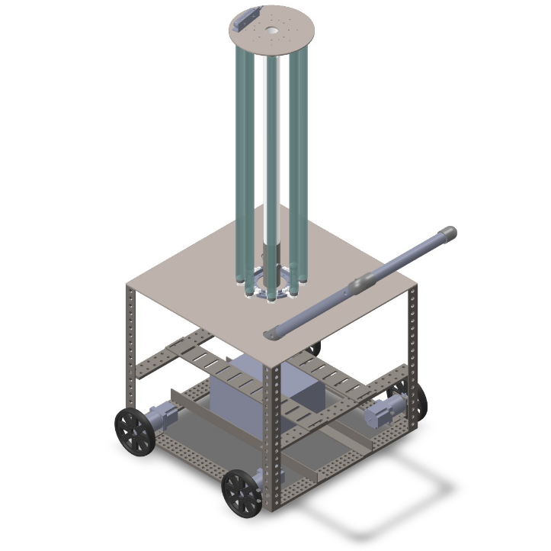
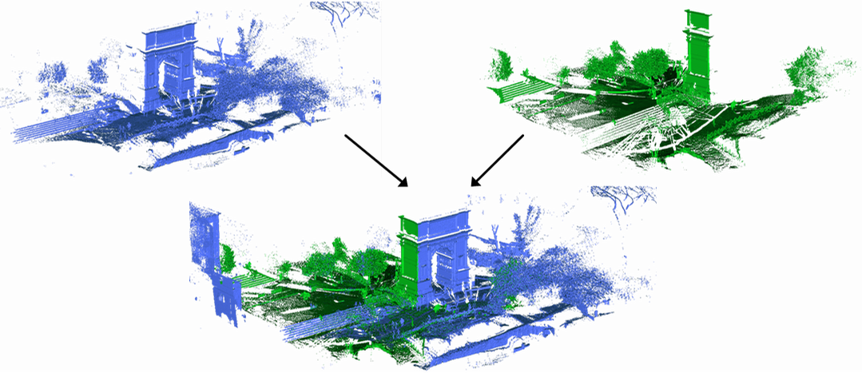
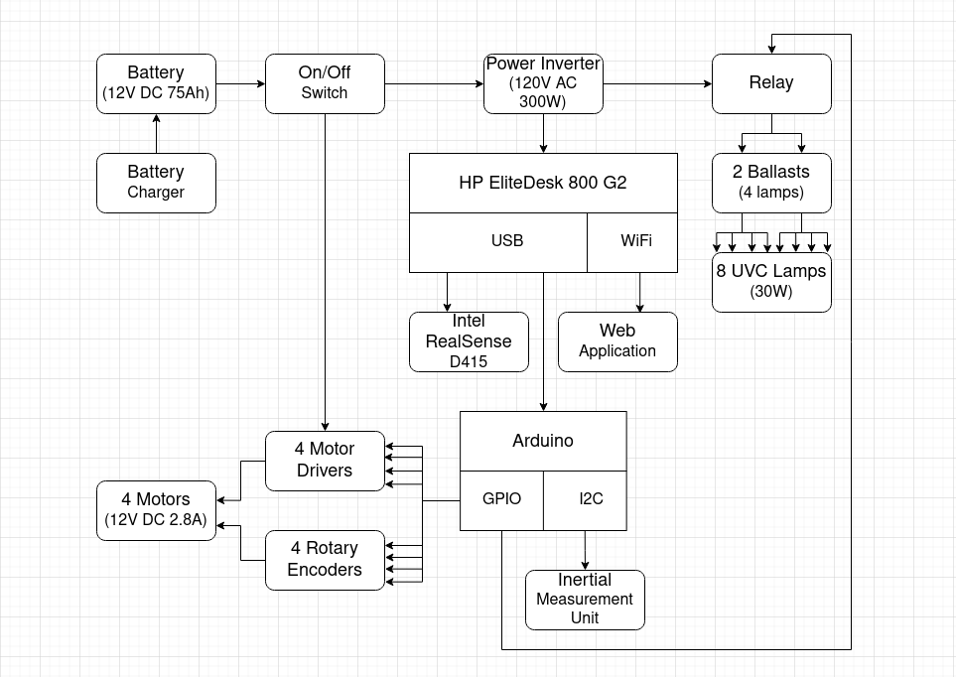
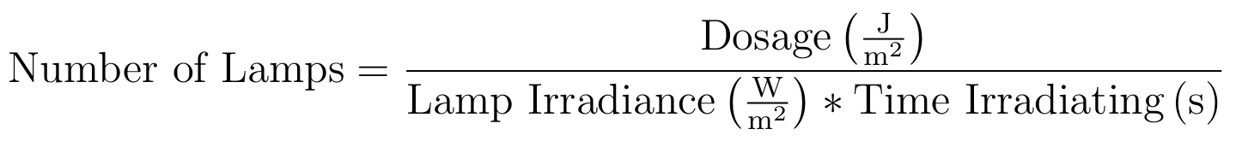



Autonomous Surface Disinfection Robot to Combat SARS-CoV-2
UCF Student Scholar Symposium
IEEE UCF Student Branch – 30 March 2022
Muibdeen Akinyele, Taylor Barnes, Juan Battaglia, John Gierlach, Hao Nguyen, Casey Sanchez, Tiefeng Yan
Abstract
Structure of Robot
Usage of Robot
With the pandemic affecting so much of our daily life around the world, we at IEEE UCF want to lend our resources and expertise toward the fight against COVID-19. Our objective is to create an autonomous robot that is capable of navigating an enclosed space (such as a hospital room) and disinfecting all of the accessible surfaces in the room using germicidal UVC radiation. The UVC lamps will be used to sanitize high-contact surfaces of SARS-CoV-2, as well as many other pathogens. The robot will work using Ultraviolet Type-C (UVC) radiation, which affects the DNA and RNA of viruses and bacteria to render them harmless. Autonomy will be achieved through a mapping system that allows the robot to navigate any enclosed space effectively. The complete autonomous functionality will also mean that the robot can be used by anyone with minimal training required, making for a more safe and accessible cleaning process.
Mechanical components:
Body This consists of a steel frame that holds all of the electrical equipment and provides structure for the robot.
Shell This is the enclosure that goes over the base to conceal sensitive equipment.
Sockets These are the devices that plug into the contacts of the lamps, connecting them to power.
Tube This is the central column that connects the bottom of the robot to the top of the lamps.
Motors Four 2.8A 1.8° stepper motors with 15:1 gearboxes will provide mobility.
Wheels Four 6-inch wheels will be driven by the motors.
To use the Disinfection Robot, the room must first be cleared of people, and all of the doors must be shut. UVC radiation is harmful to humans and viruses alike. The operator presses a button, and the robot will automatically disinfect the room. During operation, the robot will drive around the room collecting data on where surfaces exist. Once it has determined this, it will generate a "coverage path" to navigate for disinfection. It will begin radiating throughout the room while navigating the path until all of the room’s surfaces are sanitized. The spacing between segments of the path are determined by a prescribed dose of UVC that inactivates 99% of SARS-CoV-2, whose effectiveness is inversely proportional to the squared distance between the robot and the surface being disinfected. After its route is finished, the robot will send a notification to the operator via the web application. At this point, the operator may retrieve the robot for further use.
Depth Camera
Electrical components:
Battery A rechargeable 12V 75Ah lead-acid battery will provide power to the entire robot.
Charger This allows for battery recharging after use and has a cord that plugs into AC wall power.
Power Inverter This provides DC-to-AC conversion to power the lamps.
Computer An HP EliteDesk 800 G2 equipped with a 4-core 2.5GHz Intel Core i5-6500T, 16GB RAM, and 512GB HDD will control all of the robot's systems.
Ballasts These regulate AC power to the UVC lamps.
Lamps Eight Philips TUV T8 30W 1SL/25 lamps emit UVC radiation, each with a UVC output of 12.0W.
Depth Camera An Intel RealSense D415 that uses infrared stereoscopy provides point cloud data.
UVC Technology
Lamps
Tube
SLAM
UVC radiation absorption is measured in dosage (J/m^2), which is a function of the UVC power emitting from the bulb, the distance between the bulb and the surface, and the amount of time the surface spends absorbing radiation. Higher doses can inactivate virus populations by 99.9999% or higher, whereas lower doses inactivate virus populations by less. Our goal is to demonstrate inactivation of >99% of SARS-CoV-2 populations. The dosage necessary to disinfect a surface by 99% differs between different types of viruses, bacteria, and other pathogens.
Sockets
Body
Software components:
ROS Noetic Provides communication and hardware abstraction services to implement complex robot behaviors.
RealSense A ROS package for interfacing with the RealSense camera.
RTAB-MAP A ROS package for SLAM (Simultaneous Localization And Mapping).
C++ REST SDK Allows for the implementation of a RESTful API to communicate with the frontend environment.
HFSM2 A Hierarchical Finite State Machine to implement complex behaviors.
Vue A model-view-viewmodel framework for implementing user interfaces.
Motors
Figure 4: Point Cloud Data
Wheels
Simultaneous Localization and Mapping is achieved with the RTAB-MAP (Real-Time Appearance-Based Mapping) library that uses an incremental appearance-based loop closure detector. Upon loop closure the points are appended to the map and the optimizer minimizes their errors with respect to the existing map, registering the constituent point clouds. Accuracy is further concretized using an Inertial Measurement Unit to approximate the robot's orientation in space.
Figure 2: Structure of Robot
Control of Robot
The robot is controlled by an HP EliteDesk 800 G2. Figure 3 details the control flow of the entire system and how each device interfaces with the computer. The computer controls the external components via Arduino GPIO. The motors are controlled with motor driver ICs and monitored with optical rotary encoders. The lamps are switched on and off using a relay. The user controls the robot through a frontend web application implemented with Vue and Vuetify.
A 12V 75Ah battery provides power for the entire system. The motors will be running directly from this 12V power supply, but other components require different voltages. A power inverter outputs 120V AC for the computer's power supply and for the lamps.
Sources
Figure 1: Chart of UVC Data
Begić, Aladin. “Application of Service Robots for Disinfection in Medical Institutions.” Lecture Notes in Networks and Systems, Springer International Publishing, 2018, 1056–1065. Crossref, doi:10.1007/978-3-319-71321-2_89.
Heßling, Martin, et al. “Ultraviolet Irradiation Doses for Coronavirus Inactivation – Review and Analysis of Coronavirus Photoinactivation Studies.” GMS Hygiene and Infection Control; 15:Doc08, German Medical Science GMS Publishing House, May 2020, doi:10.3205/DGKH000343.
Inagaki, Hiroko, et al. “Rapid Inactivation of SARS-CoV-2 with Deep-UV LED Irradiation.”
Emerging Microbes & Infections, vol. 9, no. 1, Informa UK Limited, Jan. 2020, pp. 1744–1747. Crossref, doi:10.1080/22221751.2020.1796529.
Kowalski, Wladyslaw & Walsh, Thomas & Petraitis, Vidmantas. (2020). 2020 COVID-19 Coronavirus Ultraviolet Susceptibility.
Lindblad, Marie, et al. “Ultraviolet-C Decontamination of a Hospital Room: Amount of UV Light Needed.” Burns, vol. 46, no. 4, Elsevier BV, June 2020, pp. 842–849. Crossref,
doi:10.1016/j.burns.2019.10.004.
Storm, Nadia, et al. Rapid and Complete Inactivation of SARS-CoV-2 by Ultraviolet-C Irradiation. Research Square, 3 Sept. 2020. Crossref, doi:10.21203/rs.3.rs-65742/v1.
Suraj, Tharindu. "Disinfecting Robot with Ultraviolet Lights." 21 May 2020. Web. 29 Jan. 2021.
Sources differ on the exact dosage necessary to inactivate SARS-CoV-2 at the desired degree. Figure 1 details the dosage specified by several studies. Some of these studies call for an inactivation rate of 90%, whereas others are as high as 99.997%. Based on these sources, we determined that a safe threshold for >99% inactivation is 250 J/m^2. OSRAM has a published guide on how to calculate the number of lamps necessary to achieve a desired dosage output in a given time period. Based on the sample calculations in OSRAM's paper, we have developed the following formula for designing our robot:​
Project Sponsors
In this case, the dosage is set at 250 J/m^2. Our chosen lamps irradiate at 1 W/m^2 at a realistic distance of 1 meter. Using this equation, a robot with 8 UVC lamps would need an estimated 31.25 seconds in order to achieve our desired inactivation on a surface 1 meter away.​
​
Figure 3: Robot Control Diagram

